Slide 1
Estar
Estar is used to talk about how you feel and to say where people, places, and things are located.
Estar is also used with adjectives to talk about certain emotional and physical conditions.

Slide 2
How do you conjugate estar?

Slide 3
Remember!:
In Spanish, the forms of adjectives agree in gender and/or number with the nouns or pronouns they describe.

Slide 4
Use estar with adjectives to describe the physical condition of places and things.
La habitación está sucia.
The room is dirty.
El hotel está cerrado.
The hotel is closed.

Slide 5
Use estar with adjectives to describe how people feel both mentally and physically.
Yo estoy cansada.
I’m tired.
¿Están listos para su viaje?
Are they ready for their trip?

Slide 6
¡Attención!
Two important expressions with estar that you can use to talk about conditions and emotions are estar de buen humor (to be in a good mood) and estar de mal humor (to be in a bad mood).

Slide 7
enamorado/a (de): in love (with)
preocupado/a (por): worried (about)
Javier está enamorado de Maribel.
Estoy preocupada por el examen.

Slide 8
Él + (estar) + (adjective).

Slide 9
2. Ella ________ __________.

Slide 10
3. Mi padre _______ ________.

Slide 11
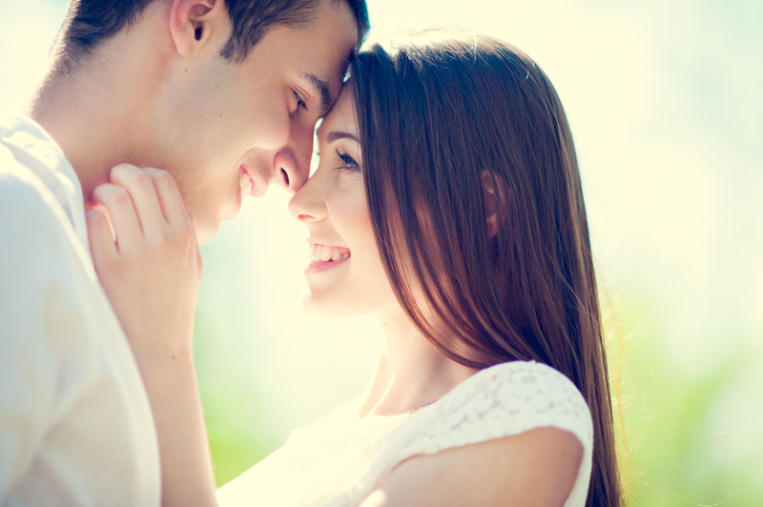
4. Ella _____ _________ __ él.

Slide 12
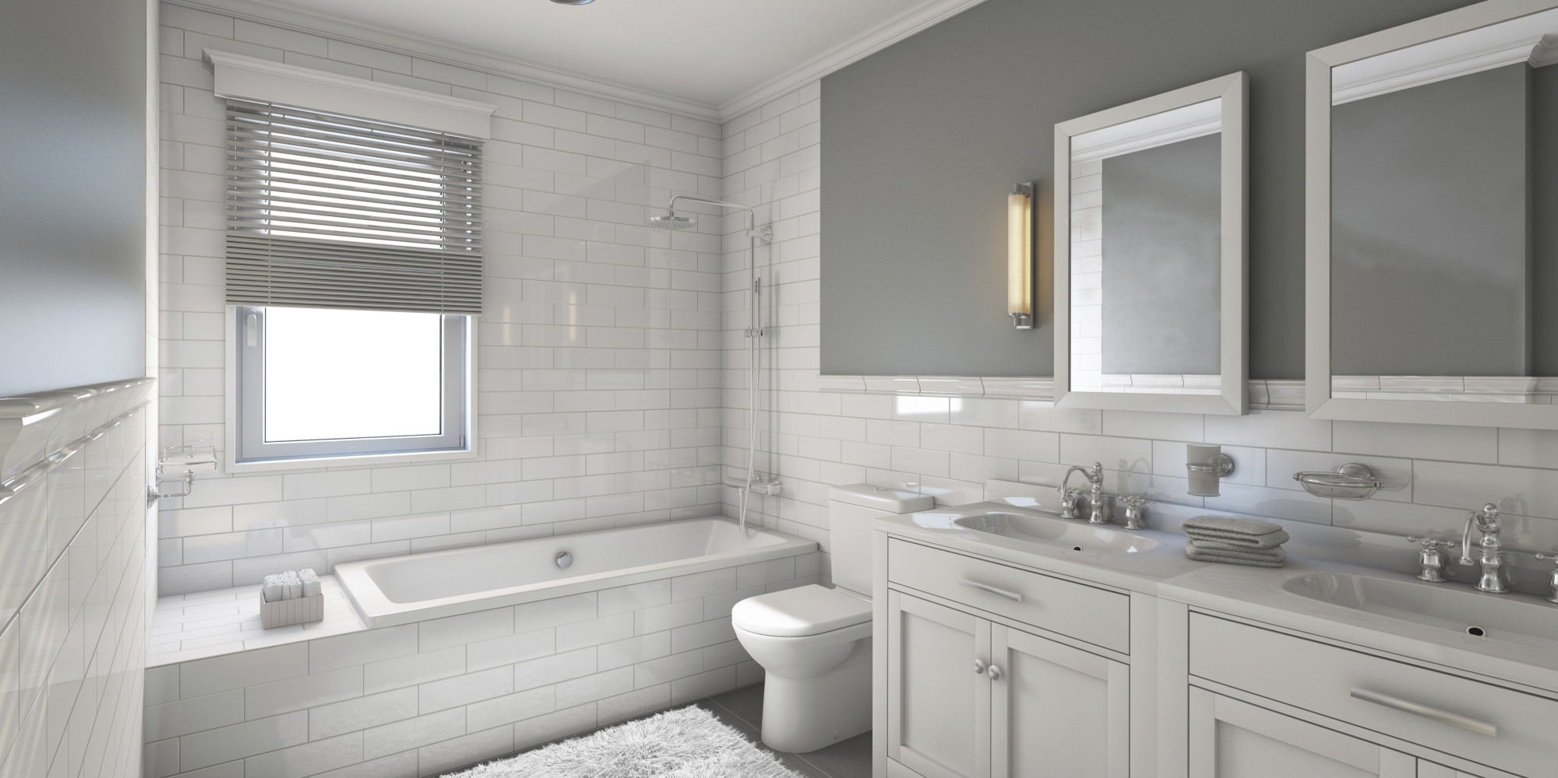
5. El baño _________ __________.

Slide 13
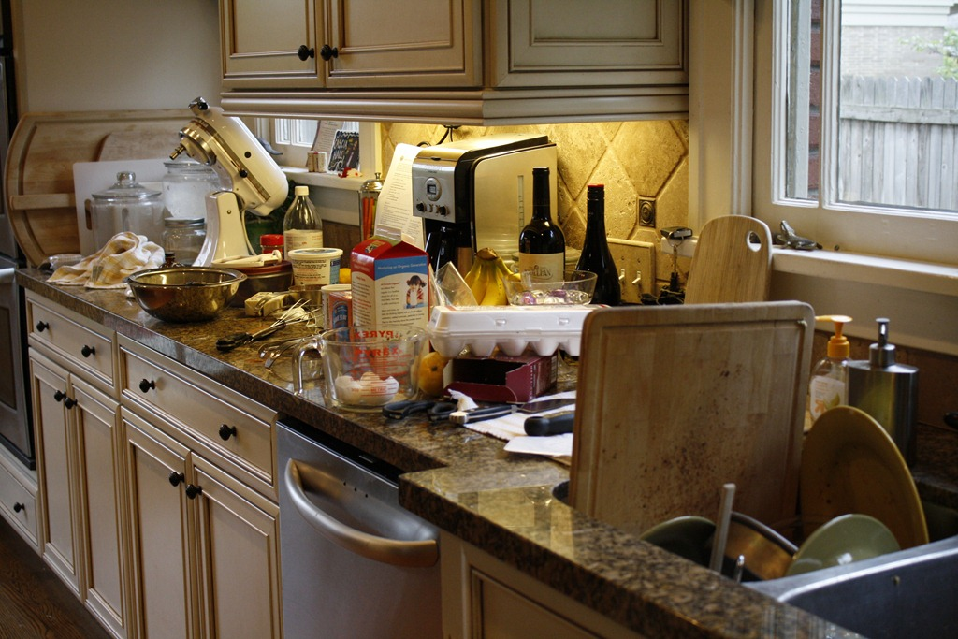
6. La cocina _________ __________.

Slide 14
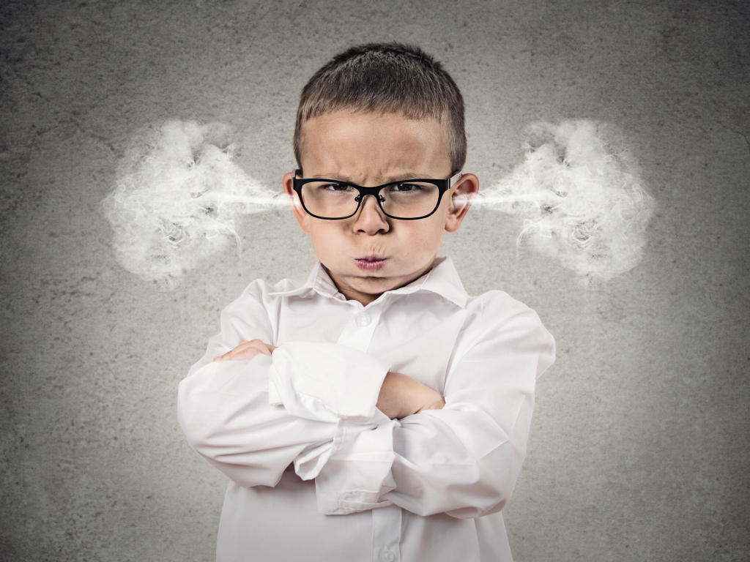
7. El niño _________ __________.

Slide 15
8.

Slide 16
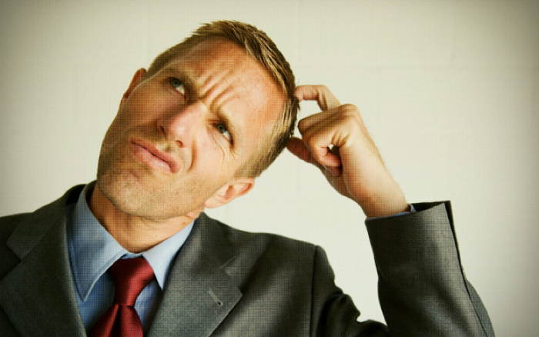
9.

Slide 17
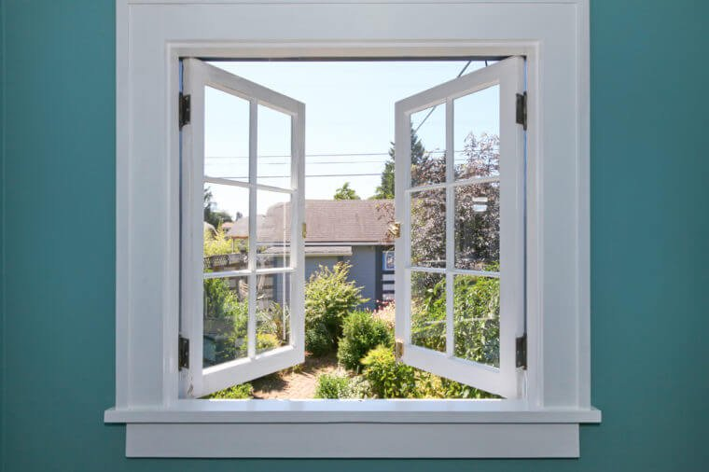
10.

Slide 18
11. La tienda (the store)

